Slide 1

Oracle 12c: SQL
Chapter 3
Table Creation and Management
©2016. Cengage Learning. All rights reserved.

Slide 2
Objectives
Identify the table name and structure
Create a new table using the CREATE TABLE command
Use a subquery to create a new table
Add a column to an existing table
Modify the definition of a column in an existing table
Delete a column from an existing table
©2016. Cengage Learning. All rights reserved.

Slide 3
Objectives (continued)
Mark a column as unused and then delete it at a later time
Rename a table
Truncate a table
Drop a table
©2016. Cengage Learning. All rights reserved.

Slide 4
Database Table
A database object
Stores data for the database
Consists of columns and rows
Created and modified through data definition language (DDL) commands
©2016. Cengage Learning. All rights reserved.

Slide 5
Table Design
Table and column names:
  Can contain a maximum 30 characters – no blank spaces
  Must begin with a letter
  Can contain numbers, underscore (_), and number sign (#)
  Must be unique
  No reserved words are allowed (SELECT, DISTINCT, CHAR, NUMBER, etc)
©2016. Cengage Learning. All rights reserved.

Slide 6
Column Design
Choose a name for each column.
Determine the type of data each column stores.
Determine (in some cases) the column’s maximum width.
Oracle 11g: SQL

Slide 7
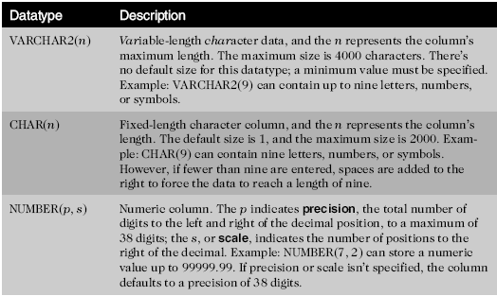
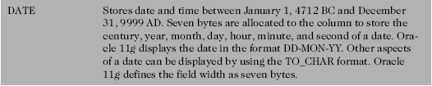
Table Design (continued)
©2016. Cengage Learning. All rights reserved.

Slide 8
Extended Data Types
Introduced in Oracle 12c:
  Enables storage of additional data bytes in specific data types
  Database parameters must be enabled by an Oracle system administrator
©2016. Cengage Learning. All rights reserved.

Slide 9

Table Creation
©2016. Cengage Learning. All rights reserved.

Slide 10
Defining Columns
Column definition list must be enclosed in parentheses
Datatype must be specified for each column
Maximum of 1,000 columns
©2016. Cengage Learning. All rights reserved.

Slide 11
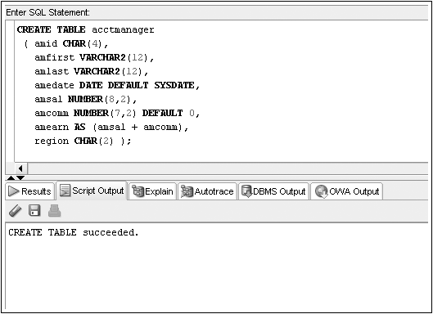
CREATE TABLE Command Example
Virtual Column
©2016. Cengage Learning. All rights reserved.

Slide 12
Viewing List of Tables: USER_TABLES
A data dictionary is a typical component of a DBMS that maintains information about database objects
You can query the data dictionary to verify all the tables that exist in your schema
The USER_TABLES data dictionary object maintains information regarding all your tables
©2016. Cengage Learning. All rights reserved.

Slide 13
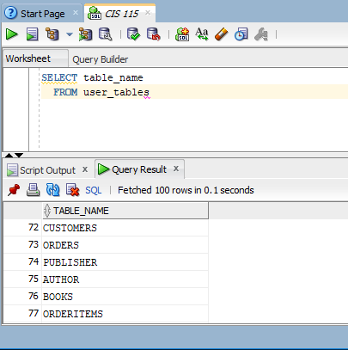
Oracle 11g: SQL

Slide 14
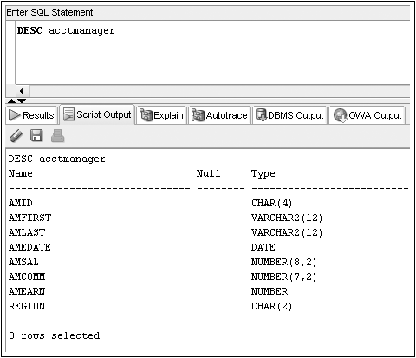
Viewing Table Structures: DESCRIBE
DESCRIBE displays the structure of a specified table
©2016. Cengage Learning. All rights reserved.

Slide 15
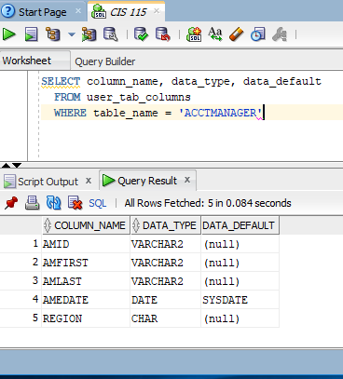
Oracle 11g: SQL

Slide 16
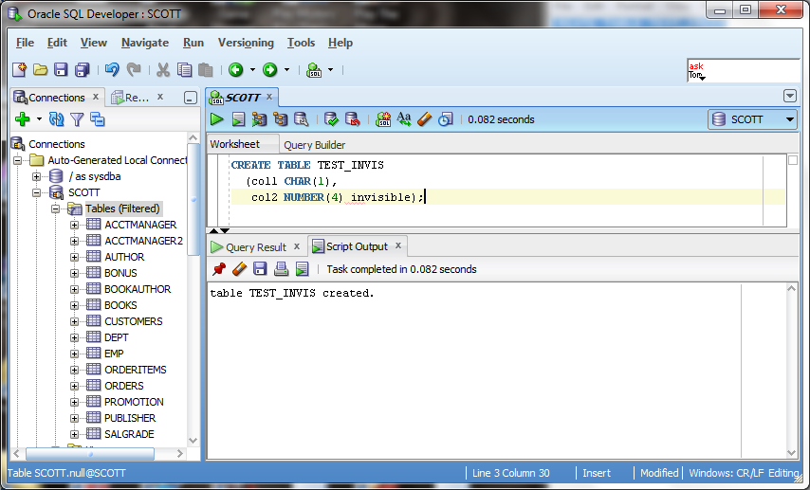
Invisible Columns
Oracle 12c allows hidden columns
©2016. Cengage Learning. All rights reserved.

Slide 17
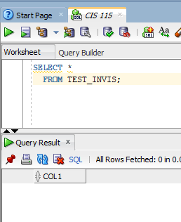
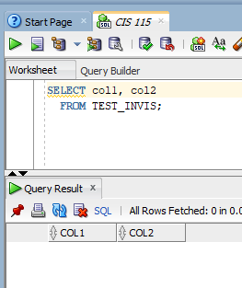
Oracle 11g: SQL

Slide 18
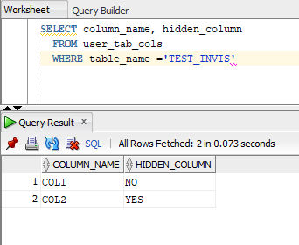
Oracle 11g: SQL

Slide 19
Table Creation through Subqueries
You can use subqueries to retrieve data from an existing table
Requires use of AS keyword
New column names can be assigned
©2016. Cengage Learning. All rights reserved.

Slide 20
CREATE TABLE…AS
©2016. Cengage Learning. All rights reserved.

Slide 21
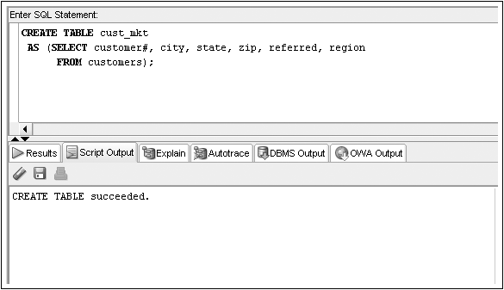
CREATE TABLE…AS Command Example
©2016. Cengage Learning. All rights reserved.

Slide 22
Try it out. . . .
DESC cust_mkt ---to verify it is there.
SELECT *
FROM cust_mkt; ---to see table
Oracle 11g: SQL

Slide 23
Modifying Existing Tables
Accomplished through the ALTER TABLE command
Use an ADD clause to add a column
Use a MODIFY clause to change a column
Use a DROP COLUMN to drop a column
©2016. Cengage Learning. All rights reserved.

Slide 24
ALTER TABLE Command Syntax
©2016. Cengage Learning. All rights reserved.

Slide 25
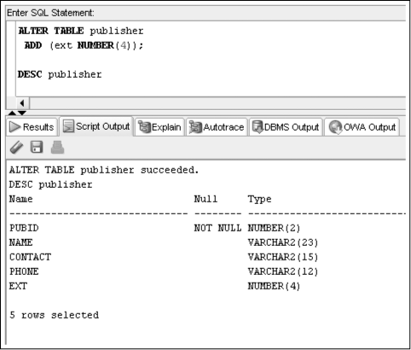
ALTER TABLE…ADD Command
©2016. Cengage Learning. All rights reserved.

Slide 26
Try it out. . . .
DESC publisher ---to verify the change was made
SELECT *
FROM publisher; ---to see table
Oracle 11g: SQL

Slide 27
ALTERING RULES
A column must be as wide as the data fields it already contains.
If a NUMBER column already contains data, you can’t decrease the column’s precision or scale.
Changing the default value of a column doesn’t change the values of data already in the table.
Oracle 11g: SQL

Slide 28
Try it out. . . .
Rule #1
ALTER TABLE books
MODIFY (title VARCHAR2 (10));
Rule #2
ALTER TABLE books
MODIFY (retail NUMBER(5,1));
Oracle 11g: SQL

Slide 29
Try it out. . . .
Rule #3 only to future rows
ALTER TABLE publisher
ADD (rating CHAR(1));
SELECT *
FROM Publisher;
ALTER TABLE publisher
MODIFY (rating Default ‘n’);
SELECT *
FROM Publisher;
Oracle 11g: SQL

Slide 30
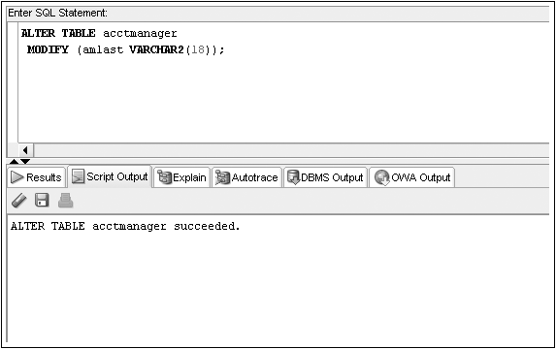
ALTER TABLE…MODIFY Command
©2016. Cengage Learning. All rights reserved.

Slide 31
Modification Guidelines
Column must be as wide as the data it already contains
If a NUMBER column already contains data, size cannot be decreased
Adding or changing default data does not affect existing data
©2016. Cengage Learning. All rights reserved.

Slide 32
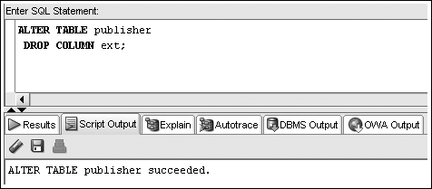
ALTER TABLE…DROP COLUMN Command
Can only reference one column per execution
Deletion is permanent
Cannot delete last remaining column in a table
©2016. Cengage Learning. All rights reserved.

Slide 33
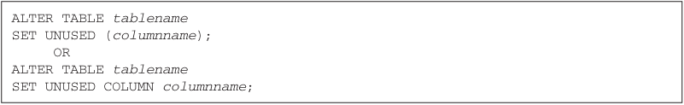
ALTER TABLE…SET UNUSED Command
Once marked for deletion, a column cannot be restored
Storage space is freed at a later time
©2016. Cengage Learning. All rights reserved.

Slide 34
ALTER TABLE…DROP UNUSED Command
Frees up storage space from columns previously marked as unused
©2016. Cengage Learning. All rights reserved.

Slide 35
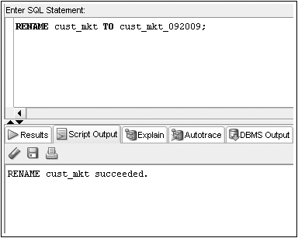
Renaming a Table
RENAME…TO is used to rename a table – the old name is no longer valid
©2016. Cengage Learning. All rights reserved.

Slide 36
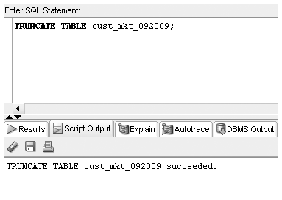
Truncating a Table
TRUNCATE TABLE command – rows are deleted
Structure of table remains
©2016. Cengage Learning. All rights reserved.

Slide 37
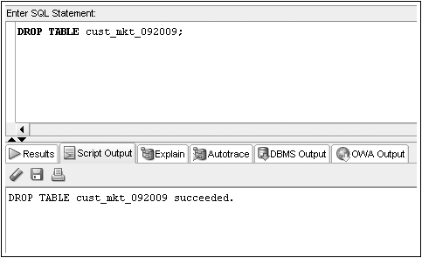
Deleting a Table
DROP TABLE command – table structure and contents are deleted
©2016. Cengage Learning. All rights reserved.

Slide 38
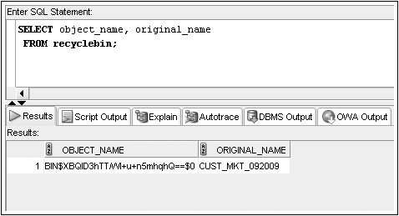
DROP TABLE without
Purge Option
Oracle 10g introduced a recycle bin
Dropped tables can be recovered from the recycle bin
©2016. Cengage Learning. All rights reserved.

Slide 39
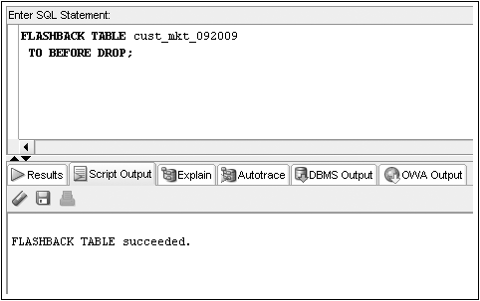
FLASHBACK Command
The FLASHBACK command recovers a table from the recycle bin
©2016. Cengage Learning. All rights reserved.

Slide 40
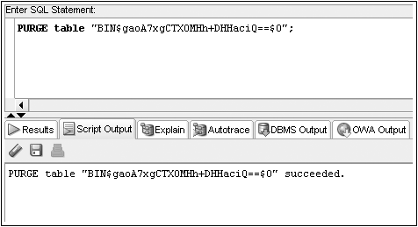
Use PURGE to Remove a Table from the Recycle Bin
©2016. Cengage Learning. All rights reserved.

Slide 41

PURGE Option Available for
DROP TABLE Command
Using the PURGE option will permanently remove a table from the database
The table will not be copied into the recycle bin
©2016. Cengage Learning. All rights reserved.

Slide 42
Summary
You create a table with the CREATE TABLE command
Each column to be contained in the table must be defined in terms of the column name, data type, and for certain data types, the width
A table can contain up to 1000 columns
Each column name within a table must be unique
You can change the structure of a table with the ALTER TABLE command
Columns can be added, resized, and even deleted with the ALTER TABLE command
Tables can be renamed with the RENAME...TO command
©2016. Cengage Learning. All rights reserved.

Slide 43
Summary (continued)
To delete all the rows in a table, use the TRUNCATE TABLE command
To remove both the structure of a table and all its contents, use the DROP TABLE command
A dropped table is moved to the recycle bin and can be recovered using the FLASHBACK TABLE command
Using the PURGE option in a DROP TABLE command permanently removes the table, meaning you cannot recover it from the recycle bin
©2016. Cengage Learning. All rights reserved.

